Slide 1
Employee Data Analysis using Excel
STUDENT NAME: S R DHARANA
REGISTER NO: 122202145 (6432098B2E173B79E8F46C104D105F2C)
DEPARTMENT: BCOM CS
COLLEGE: ANNA ADARSH COLLEGE FOR WOMEN

Slide 2
PROJECT TITLE
Employee Performance Analysis using Excel

Slide 3


AGENDA
Problem Statement
Project Overview
End Users
Our Solution and Proposition
Dataset Description
Modelling Approach
Results and Discussion
Conclusion
3/21/2024 Annual Review

Slide 4

PROBLEM STATEMENT
GOAL SETTING
PERFORMANCE REVIEW
PERFORMANCE IMPROVEMENT PROCESS
DECREASSED PRODUCTIVITY
DIFFICULTY PRIORITIZING TASKS
COMMITTING ERRORS IN PROJECT
MISSING DEADLINES

Slide 5

PROJECT OVERVIEW
Define your goals and objectives
Gather and analyze your data
Choose the right data visualization
Organize your data
Review and finalize your report

Slide 6

WHO ARE THE END USERS?
Human resources
Management and leadership
Finance department
Employees
It department
Legal and compliance teams
Data analysts and business
Marketing and communication

Slide 7

OUR SOLUTION AND ITS VALUE PROPOSITION
Conditional formatting – missing
Filter – remove
Formula – performance
Pivot – summary
Graph – data visualization

Slide 8
Dataset Description
Employee =- Kaggle
26-features
9-features
Emp id- num
Name-text
Emp type
Performance level
Gender-male female
Employee rating - num

Slide 9
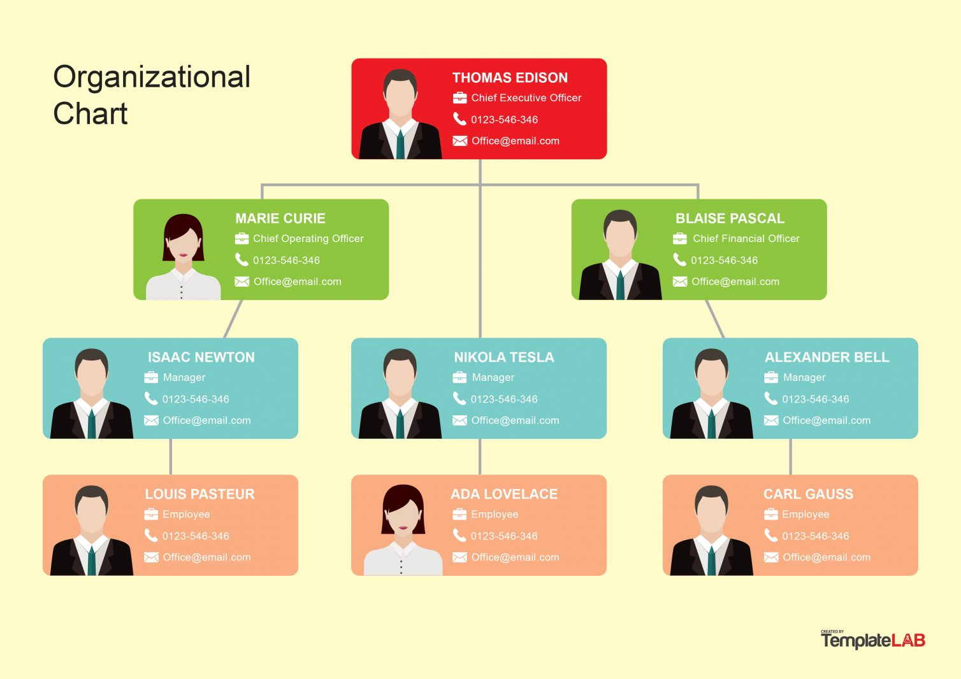

THE "WOW" IN OUR SOLUTION
3/21/2024 Annual Review
9

Slide 10

MODELLING
Data collection
Feature Collection
Data cleaning
Performance level
Techniques
Results
Pivot table
Chart graph
10

Slide 11
RESULTS
11

Slide 12
RESULTS

Slide 13
conclusion
Overall performance: the majority of employees are meeting or exceeding performance
Expectations and quality of work across the team
Top performance: these individuals might be considered for leadership roles or special projects
Areas for improvement: skills gaps that may require targeted training or coaching
Impact of training process: employees who have undergone recent training programs show noticeable improvement in their performance
Recommendations for management : refine training programs to address any identical skills gaps

